Slide 1

Quasi-normal mode Coupling Theory yiqi Wang Oct 21, 2022 Harris group Journal club
Yale
Quasi-normal coupled mode theory, H Zhang, OD Miller arXiv:2010.08650

Slide 2
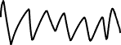

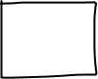
Point Oscillator
Solve it in the time domain
Solve it in the frequency domain

Slide 3
Point Oscillator
Here, frequency is always real. However f[w] could be complex for mathematical convenience.

Slide 4
Point Oscillator
Eigenmode Equation

Slide 5
Lossy Point Oscillator

Slide 6
Lossy Point Oscillator

Slide 7

Problem Overview
In High-Q limit, we treat the scatter as a close system, and using properties of Hermitian operators:
We Interpret the imaginary part of eigenvalues as lossy resonator linewidth.
Using perturbation theory to modify its eigenmode.
Scattered
Incident
Scatter
Scatter is consisted of several resonances (Eigenmodes)
Not treated rigorously, systematically and usually in an intuitive way.

Slide 8
Questions to answer
Modes of lossy resonator (Quasi-normal modes)
Complex eigenfrequency
Mode Coupling Theory

Slide 9


Not Self-adjoint
Not Self-adjoin Operator
Not Self-adjoin Boundary Conditions (Open)
Self-adjoint
Orthogonal
Complete
Real eigenvalues
Normal Modes
Finite Well with lossless medium
Infinite Well with lossy medium

Slide 10
Not Self-adjoint
Not Self-adjoin Operator
Not Self-adjoin Boundary Conditions (Open)
Self-adjoint
Orthogonal
Complete
Real eigenvalues
Non-orthogonal basis
Complex eigenvalues
Normal Modes
Quasi-Normal Modes

Slide 11
Scattering Framework
Symplectic Representation
Lossy; Anisotropy; Irreciprocal; Dispersive

Slide 12
Scattering Framework
Separate Variable

Slide 13
Scattering Framework
Complex Continuation
The response function (Green function) diverges at eigenvalue w_0
Or called simple poles

Slide 14
Scattering Framework
Mittag-Leffler
Expansion:
POLE EXPANSION
REPRESENTATIONS
Meromorphic function
no pole at 0
Entire function

Slide 15
Scattering Framework
POLE EXPANSION
REPRESENTATIONS
Bounded at infinity
h(0)=0
Resonance Part

Slide 16
Scattering Framework
POLE EXPANSION
REPRESENTATIONS
High Q limit
Single Lorentzian
Circle parametric representation

Slide 17
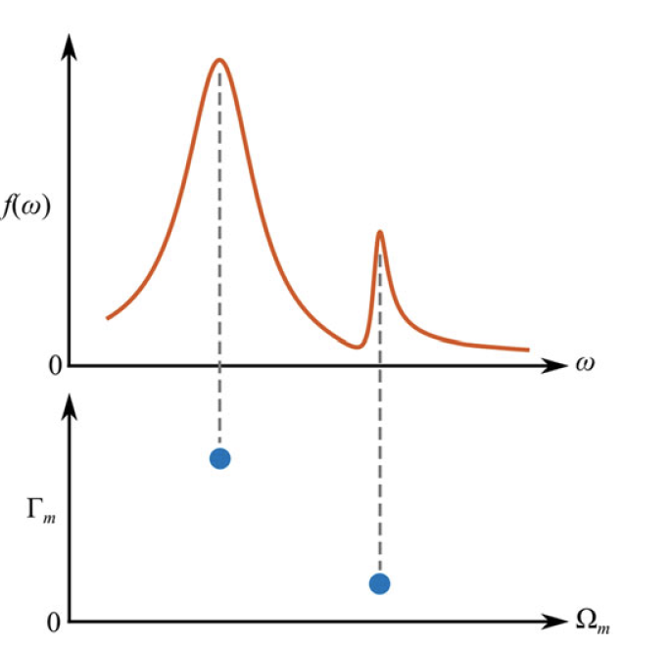
Scattering Framework
POLE EXPANSION
REPRESENTATIONS
Low Q

Slide 18
Quasi normalmodes
Do not assume reciprocity of B
Cotangent Space
orthogonality normalization relation

Slide 19
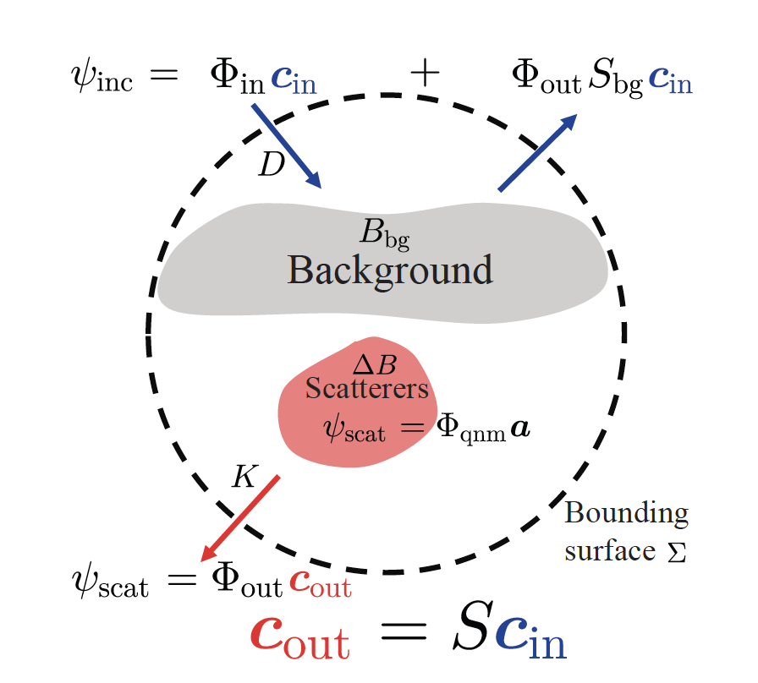
Quasi-normalmode Coupled Mode Theory

Slide 20
Quasi-normalmode Coupled Mode Theory
QNM amplitudes a are large:
Large overlap with the incident field
Near the high-Q

Slide 21
Quasi-normalmode Coupled Mode Theory

Slide 22
Quasi-normalmode Coupled Mode Theory

Slide 23
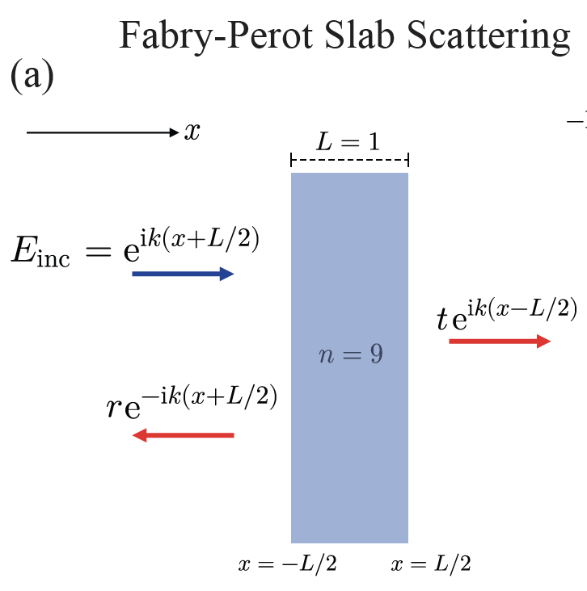
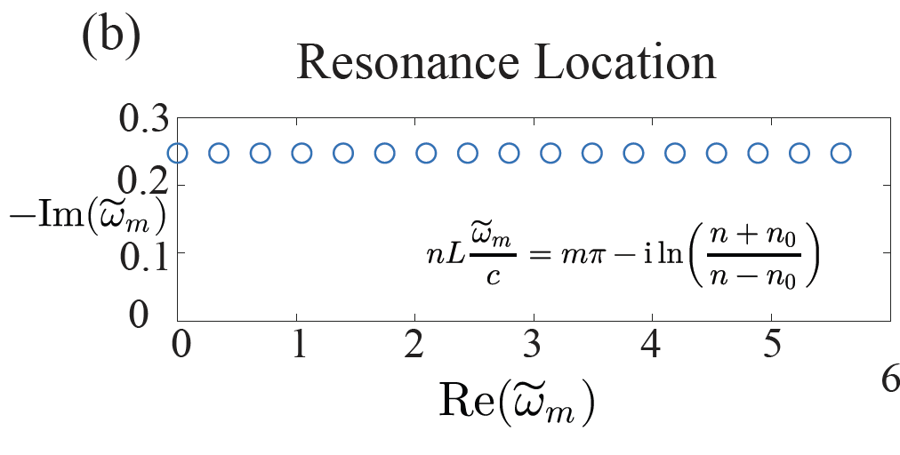
1D F-P Slab
Scattering

Slide 24
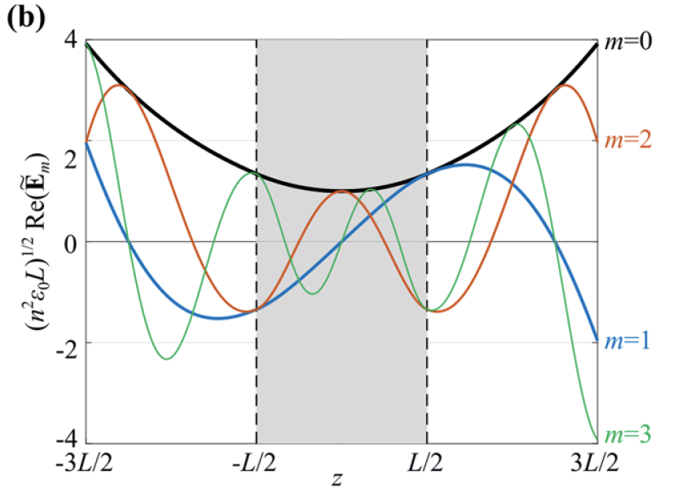
1D F-P Slab
Scattering

Slide 25
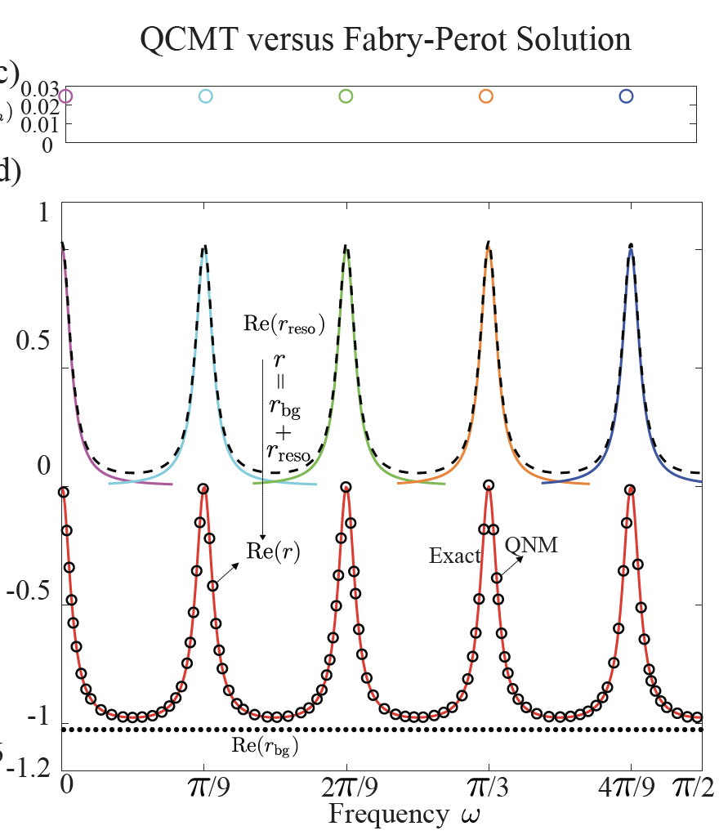
1D F-P Slab
Scattering

Slide 26
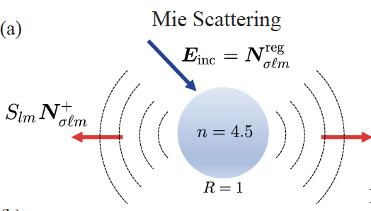
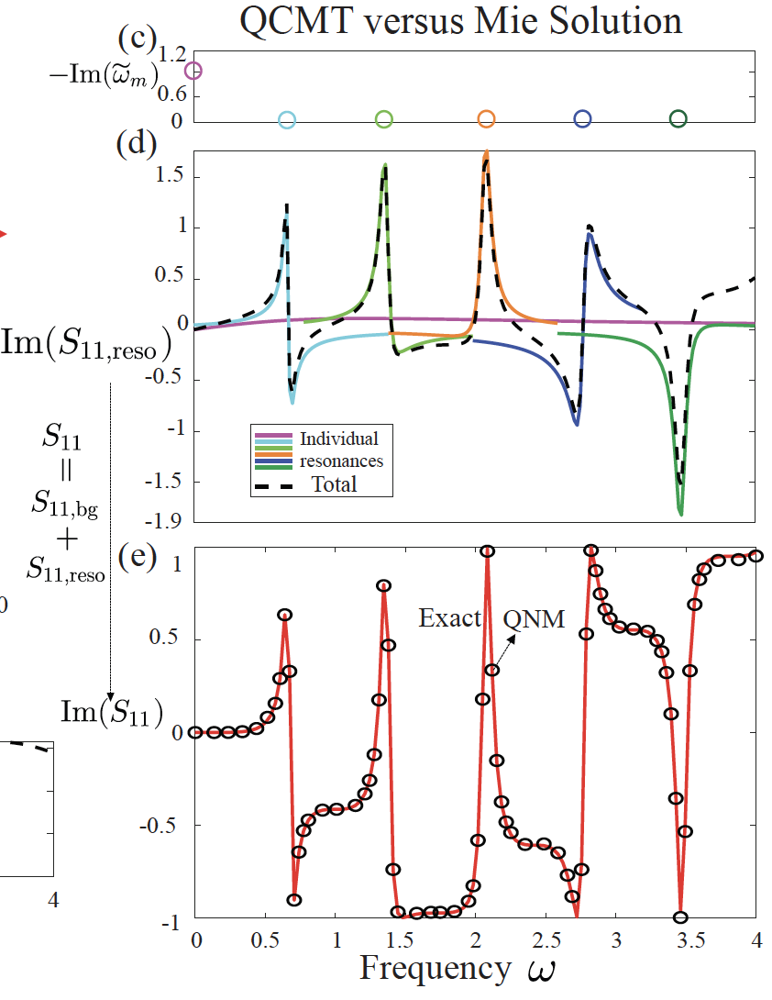
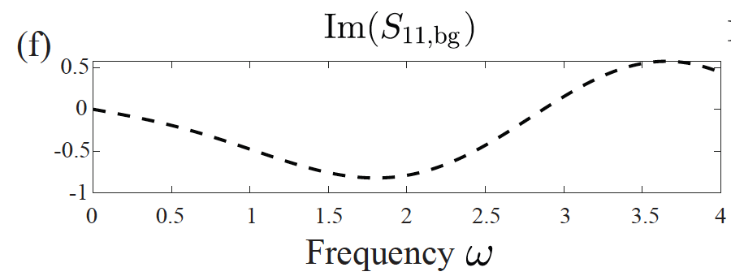
Mie
Scattering

Slide 27
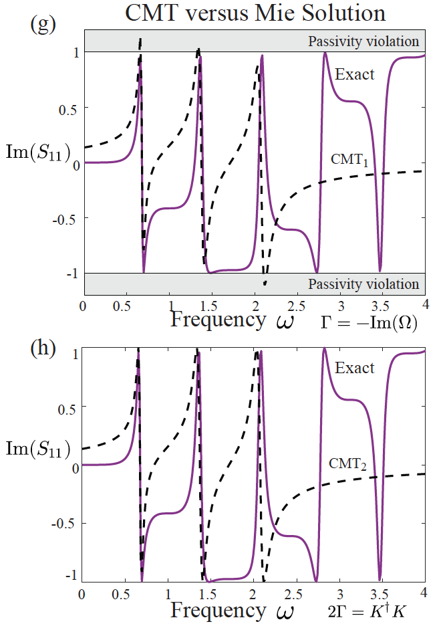
Mie
Scattering

Slide 28
When is
CMT accurate?
(1) The Born-scattering background term is small;
(2) The coupling strengths D and K must be approximately frequency-independent over the bandwidth of interest.

